Slide 1
COLOUR GRADING & CORRECTION
What is the difference? Why are they used?

Slide 2
COLOUR CORRECTION & GRADING WORKFLOW
At its most basic level, colour correction can be split into 3 steps:
Correcting issues between individual shots (Colour correction)
Shot-to-shot consistency adjustment (Secondary correction)
Applying a final “look”/style (Grading)

Slide 3
Colour correction/grading in animation
2D digital animation usually has less of a need for colour correction if it's been completely created and worked on in a software with a pre-selected, limited colour palette.
Stop-motion and other camera-shot material has a need for correction because of the various real-world influences of lighting, exposures, and luma / colour balance in the camera settings.
3D digital animation relies much more on colour correction because of all of the variables in simulated camera lens, lighting, surface textures, effects and compositing.
Notes:
2D: But, the application of effects and compositing may influence this. Also, if original colour choices have been made without a properly colour calibrated monitor and high quality graphics card, you may in for some surprises when seeing your rendered movie through professional projectors and displays.
Stop-mo: You might not even notice how a light's bulb can have a slight shift in its brightness and colour as it ages.

Slide 4
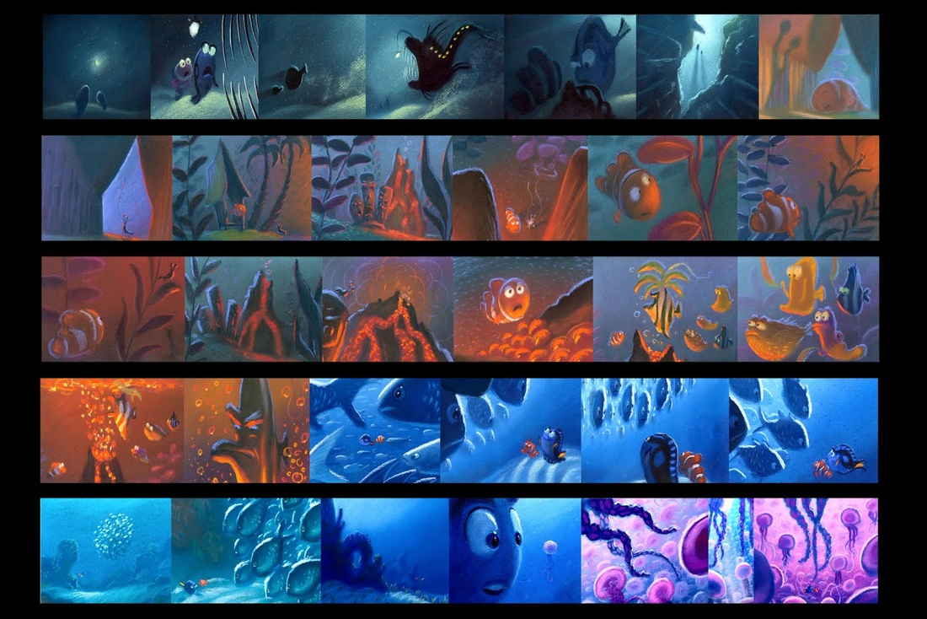
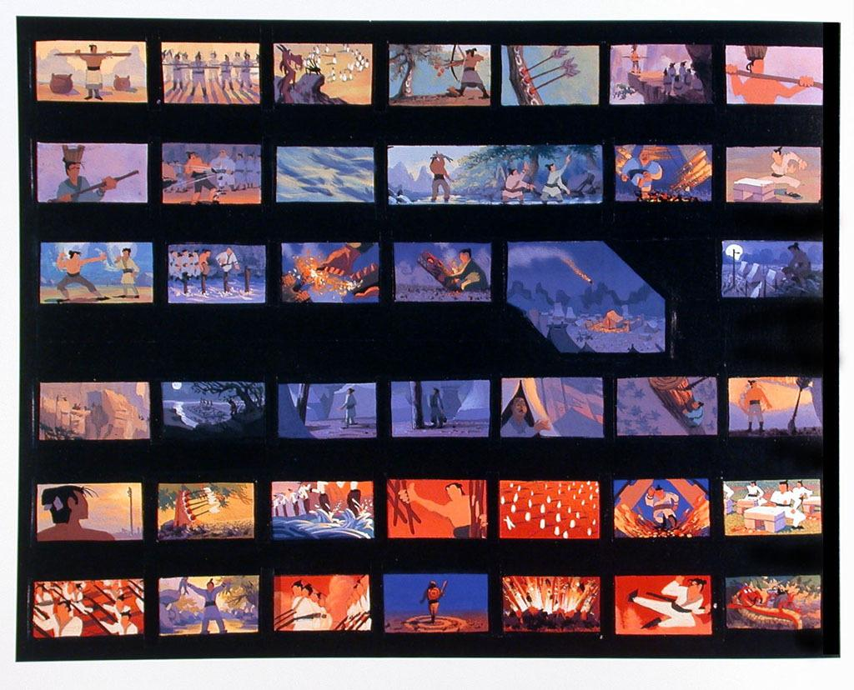
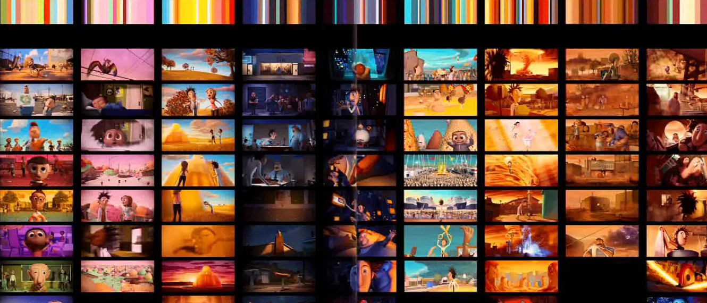
COLOUR SCRIPT
Colours have various mood connotations, and combining them can subconsciously make the viewer experience different emotions.
Color scripting is a process of mapping out the colour, lighting, and emotional connotations of an animated video in an animation or film.
A colour script can be valuable to reference when in the colour grading process of your film.
Colour script from Finding Nemo (2003)
Colour script from Mulan (1998)
Colour script from Cloudy With a Chance of Meatballs (2009)
Notes:
Colours have various mood connotations, and combining them can subconsciously make the viewer experience different emotions. The main goal is to craft and use colours to serve the story expression and experience in one way or another.
Color scripting is a process of mapping out the colour, lighting, and emotional connotations of an animated video in an animation or film. A colour script is a sequential and visual outline, explaining how colours will be used throughout the length of the animation or film.

Slide 5
GRADING VS CORRECTION
CORRECTION
Involves modifying colour and luma qualities to get the proper set of colours as close as possible to how the human eye normally sees
Matching the colours in different footage with each other
Creates visual consistency in your footage
Allows for more precision during the more creative grading process
GRADING
Subjective/creative choice choosing colours which set the mood mood, energy and meaning of a scene
Adding or subtracting colours from footage/using highly stylized or unusual palette which serves the film
For finding the “final look” of your film, colour-wise

Slide 6
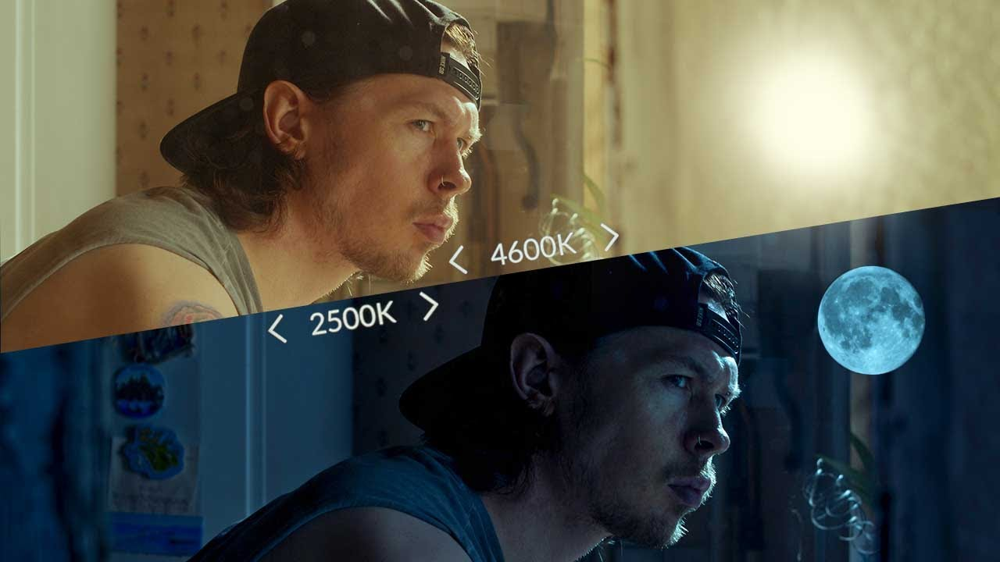
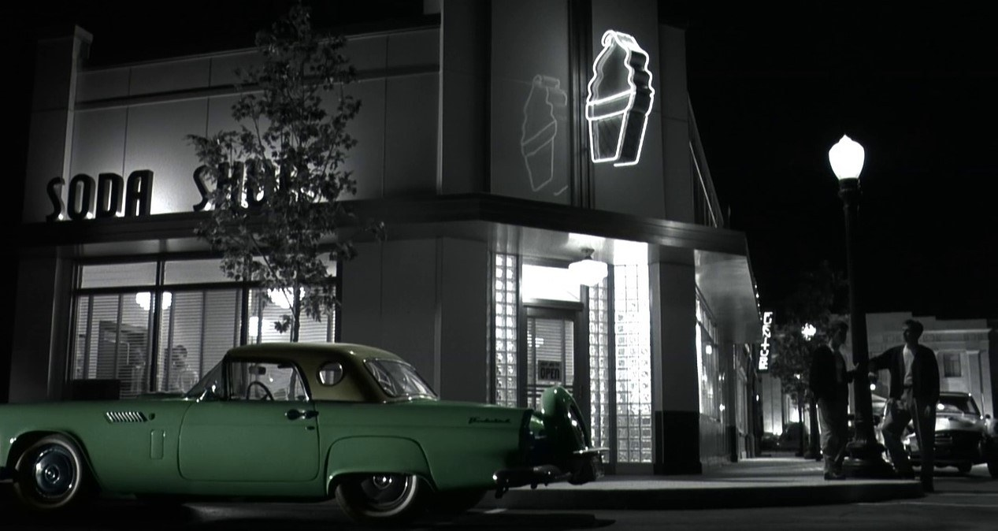
GRADING VS CORRECTION - continued
Both are used to adjust footage to transform a certain place or time of day to another–for example, “day for night” (when footage shot in the day is colour corrected/graded in post to appear as if it was shot at night)
Both can be used for secondary correction–when changing one colour in a shot to another
An example of how “day-for-night” changes the mood of a scene
Targeted colour correction/grading from Pleasantville (1998)

Slide 7
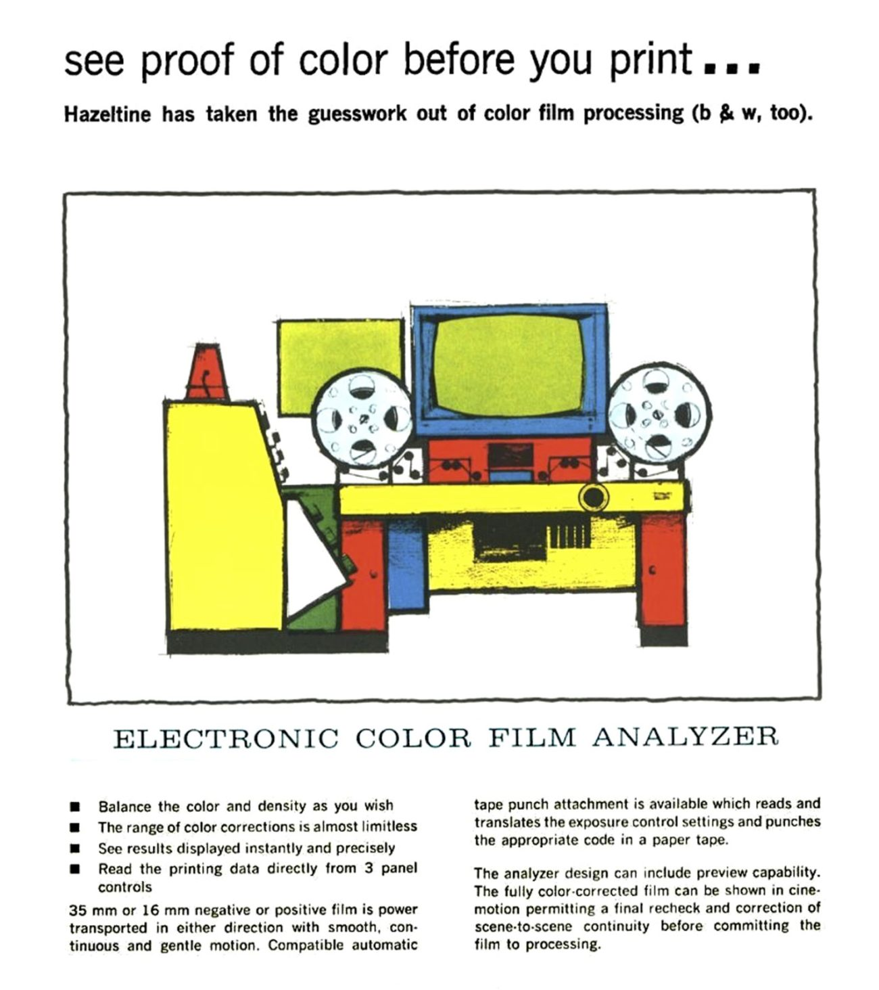
COLOUR TIMING
Refers to a process done in analogue filmmaking after the film negative (the original celluloid source) has been developed, but before it is printed.
The negative is fed through a specialized machine (left) which functions as a light box with adjustable colours separated into channels, there is also a camera feed into a monitor which flips the negative to a positive video image, allowing the user to view the emulated response of the chosen print stock.
The Colour Analyzer tracks exactly how many feet and frames into the film the user is at any given moment, so that you may perform adjustments to specific scenes and shots.
Above: A 1966 print ad for the Hazeltine Color Analyzer

Slide 8
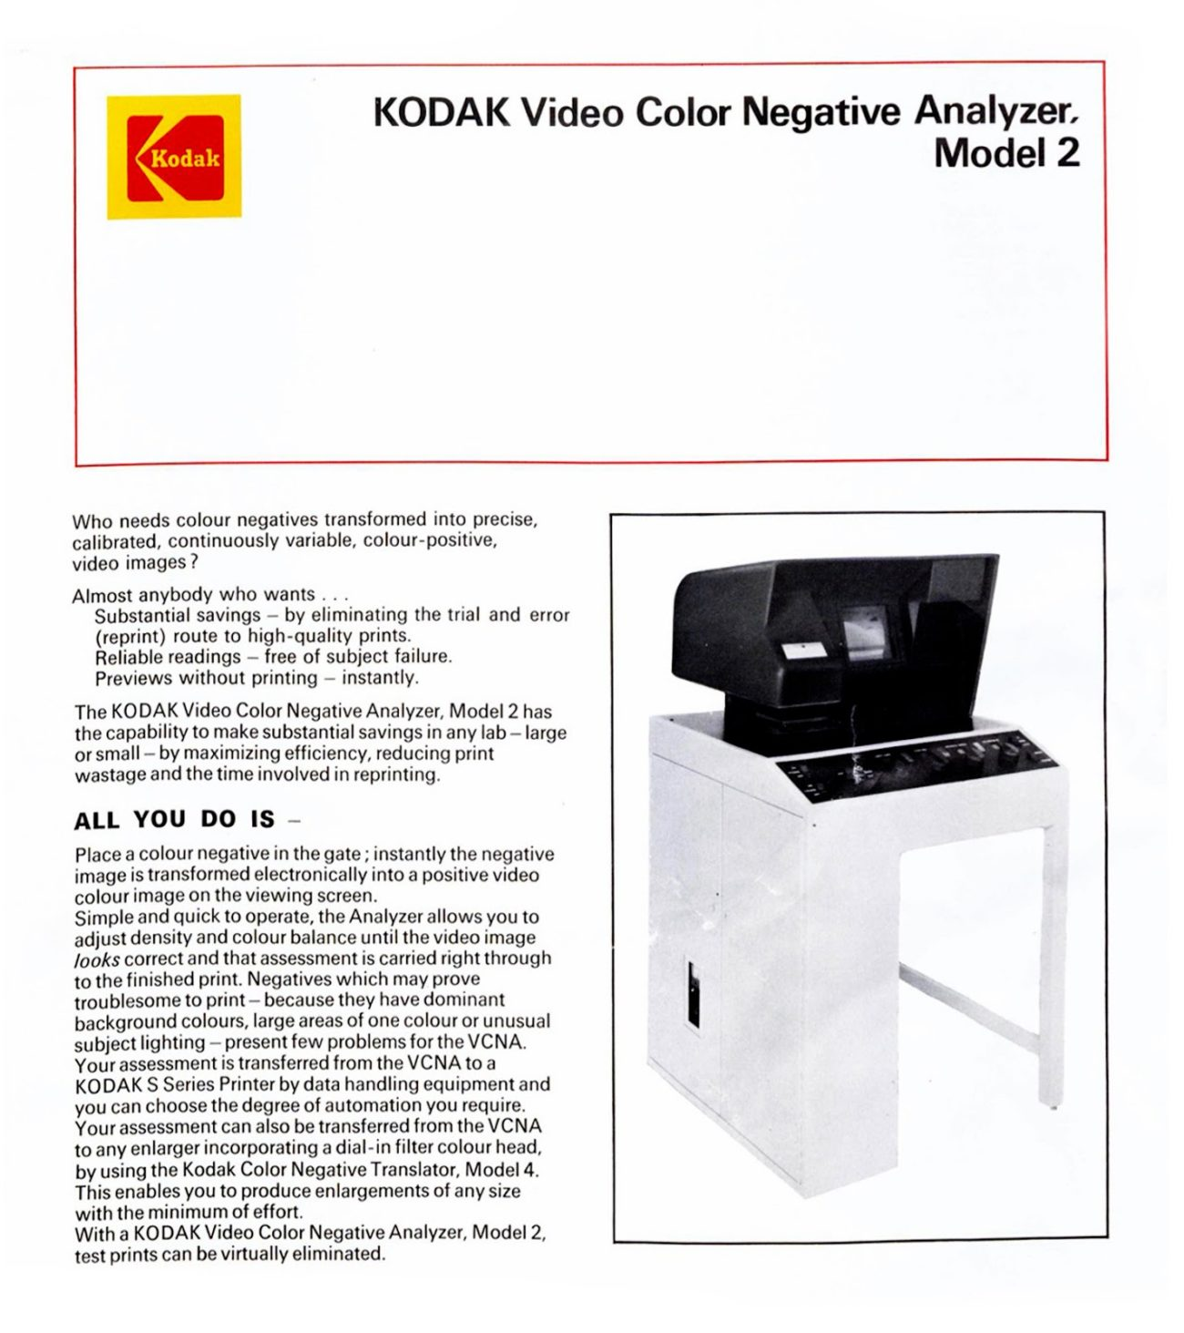
COLOUR TIMING - continued
​The colour analyzer has wheels for red, green, blue, a master wheel for light values that can be used to adjust each scene chronologically.​
The user then performs adjustments to the colour density and balance until the video image looks correct, this data is recorded onto a strip of tape and will be referenced in the final print.​
The final colour timed print is called the film positive, although it is technically a negative of a negative (meaning each light value is a mirrored/backwards value of the original negative)​
Above: the Kodak counterpart, used to preview and program colour and exposure adjustments (known as printer points)
Notes:
The colour analyzer has wheels for red, green, blue, a master wheel for light values that can be used to adjust each scene chronologically.
The user then performs adjustments to the colour density and balance until the video image looks correct, this data is recorded onto a strip of tape and will be referenced in the final print.
The final colour timed print is called the film positive, although it is technically a negative of a negative (meaning each light value is a mirrored/backwards value of the original negative)

Slide 9
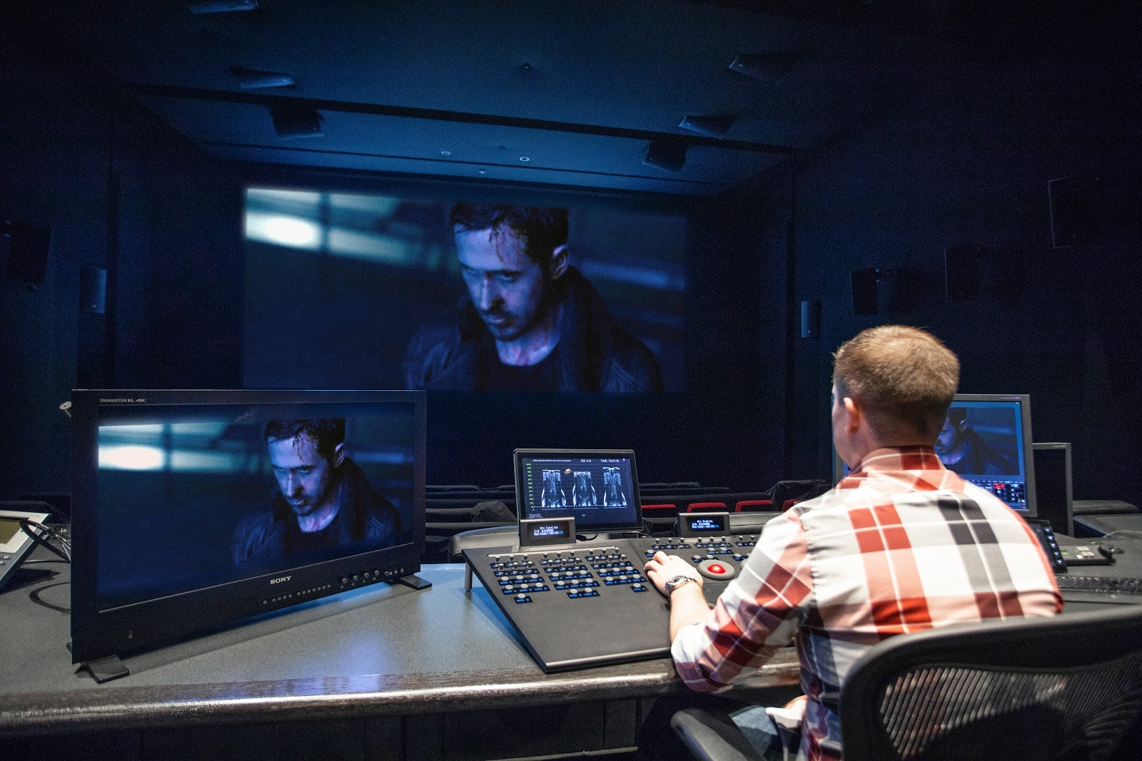
With the advent of digital media, analogue colour timing has mostly fallen out of fashion in favour of the software based digital intermediate process (DI) for both digitally shot "film" and celluloid.

Slide 10
COLOUR CORRECTION FIRST PASS VS SECONDARY CORRECTION
FIRST PASS
Setting tonal range (making sure blacks are dark and whites are bright)
Remove colour casts (unwanted colours dominating your overall values)
Enhance colour (hue and saturation)
SECONDARY CORRECTION
Affecting specific tonal ranges (targeting specific colour midtones/highlights etc)
Affecting specific hues

Slide 11
Scopes - LUMA
LUMA scope
Displays the light information of an image–which parts of an image are bright and which parts are dark.
Measured units are called IRE, with 0 IRE being the darkest part of an image and 100 IRE being the brightest/whitest part.
Human skin tones (or “flesh tones”) should fall between 60-80 IRE (Using a Vectorscope is good for checking this)
When the luma values are concentrated in the middle of the scope it means the image is flat and lacks proper contrast
Uncorrected image
Notes:
You want your image to have a little bit of 0 IRE and a little bit of 100 IRE to prevent your picture from looking flat

Slide 12
Scopes - LUMA
Notice how the densest part of the luma scope corresponds to the brightest area of the image
Uncorrected image

Slide 13
Scopes - RGB Parade
RGB Parade
Displays the colour information of an image, separated into 3 channels: Red, Green, and Blue.
Uncorrected image
Notes:
With an uncorrected image, each colour channel should be approximately the same shape with usually one channel being a bit more prominent than the others (note: the example image below has more red and green than blue)

Slide 14
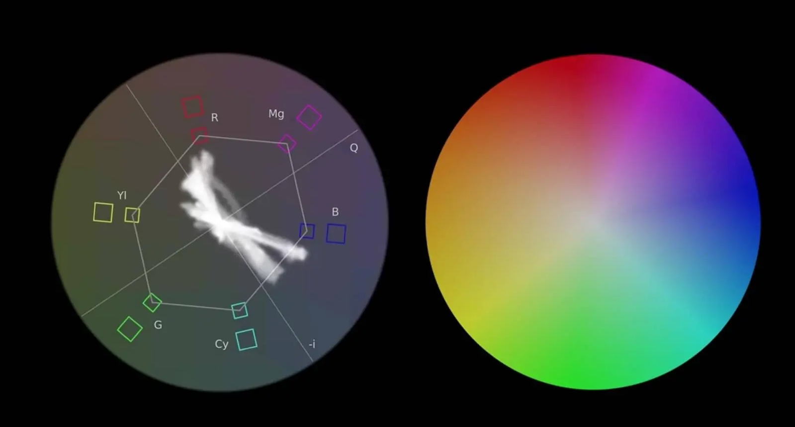
Scopes - Vectorscope
Vectorscope
Represents the hue and saturation of an image
Does NOT read luma values, only chroma (colour)
Fixing skin tone should be one of the last things you adjust when colour correcting
Skin tone line
Notes:
Chroma values become more saturated towards the edge of the circle, become lighter/more desaturated towards the center
The smaller boxes indicate a “safe” area for chroma values, values outside of the hexagon shape are considered “illegal” non-broadcast safe colours
All human skin tones (also referred to as “flesh tones”) typically fall along the “skin tone line” indicated on the left diagram between the yellow and red values

Slide 15
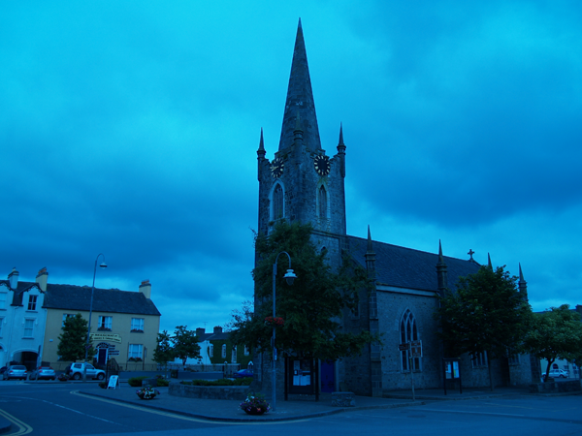
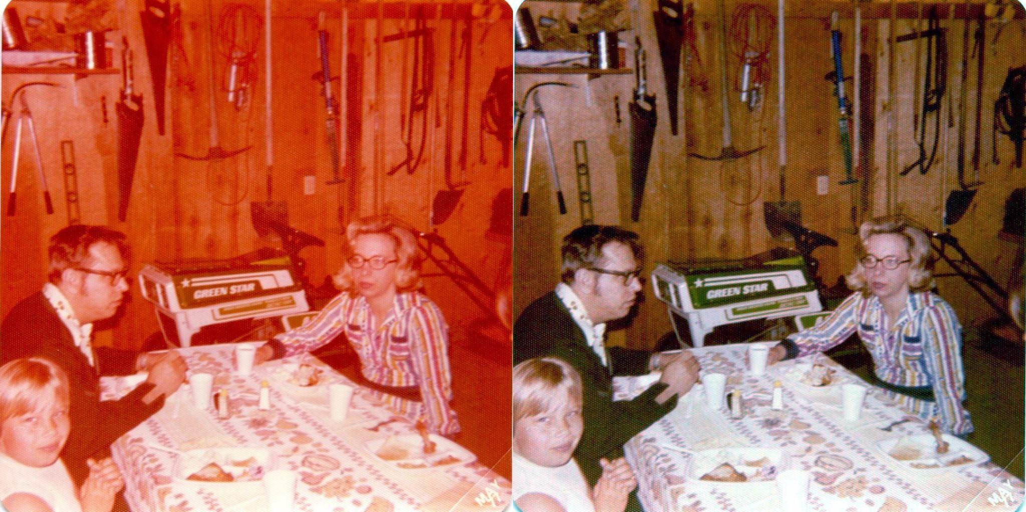
COLOUR CASTS
Colour cast refers to a visible, usually unwanted, tint to a photo
Caused by different types/intensities of light
Example: daylight can create a blue tint in the right circumstances, or a low watt indoor light can create a red or yellow colour cast
When working with a strong unwanted colour cast, it is best to begin by removing the unwanted tint first before moving to your luma values
An image with a strong green colour cast due to the green screen in the background.
An image shot outdoors on a cloudy day with a strong blue colour cast.
Left above: example of a photo shot on film with a strong red colour cast that has been corrected digitally in the image on the right.

Slide 16
More terminology
“Hero” shots
One colour corrected shot used as references for all other colour corrections in a particular scene
Used to create visual consistency between shots, especially if footage has been shot at different times of days/different locations
Usually best to choose a wide or medium-wide establishing shot with the widest range of luma and chroma values to use as your guide
TEMPERATURE
Adjusts chroma along a blue–orange spectrum
TINT
Adjusts chroma along magenta–green spectrum

Slide 17
GAMMA
In photography and film, gamma refers to the way light values are encoded linearly to represent the non-linear way the human eye perceives light.
The human eye can recognize smaller changes in dark values than it can in light values
The way gamma is “corrected” depends on your viewing environment.
This has to do with the “simultaneous contrast” phenomenon–the two middle grey boxes appear to be different shades of gray because of the way our eyes perceive contrast–the same shade of gray will look different in a lighter environment than it will in a dark environment
RAW image files have linear gamma/no colour profile associated with them ("flat" looking colours)
DISCLAIMER: This is a very simplified explanation of a complex mathematical and scientific concept, for a more detailed understanding of gamma and its properties, see the links below
More in-depth info on gamma
Even more info on gamma
Notes:
In photography and film, gamma refers to the way light values are encoded linearly to represent the non-linear way the human eye perceives light. Gamma-correction refers to offsetting a linear gamma from a camera to “correct” an image to appear closer to how the human eye perceives light and dark values
The human eye can recognize smaller changes in dark values than it can in light values
The way gamma is “corrected” depends on your viewing environment and whether or not your output is meant for broadcast or if it is only going to be viewed online
This has to do with the “simultaneous contrast” phenomenon–the two middle grey boxes appear to be different shades of gray because of the way our eyes perceive contrast–the same shade of gray will look different in a lighter environment than it will in a dark environment
RAW image files have linear gamma/no colour profile associated with them (think of a flat, uncorrected image), so gamma correcting to either 2.2/2.4 depending on your viewing environment is usually standard
DISCLAIMER: This is a very simplified explanation of a complex mathematical and scientific concept, for a more detailed understanding of gamma and its properties, see the links below

Slide 18
More Tutorials on Colour Correction & Grading
Colour picking tutorial
Basic Colour Correction LinkedIn Learning course
Colour Correction VS Grading
Introduction to using scopes for colour correction
VIDEO: Colour Grading 3D Animation in DaVinci Resolve
ACES colour space & 3D Animation

