Slide 1
Colour Picking Tutorial

Slide 2
KEY CONCEPTS
Digital images for devices & displays are composed using RGB colour model.
Artwork is typically created on devices & software which display color using the sRGB color space.
Colours intended to be screened in a theater may be set up in the Rec. 709 colour space, or ACES
Only colour-managed software like Maya, Photoshop, Nuke, After Effects, Harmony and DaVinci Resolve, etc, recognize color space information & allow for accurate color preview.
A properly calibrated monitor & a controlled lighting space are required for accurate colour preview.

Slide 3
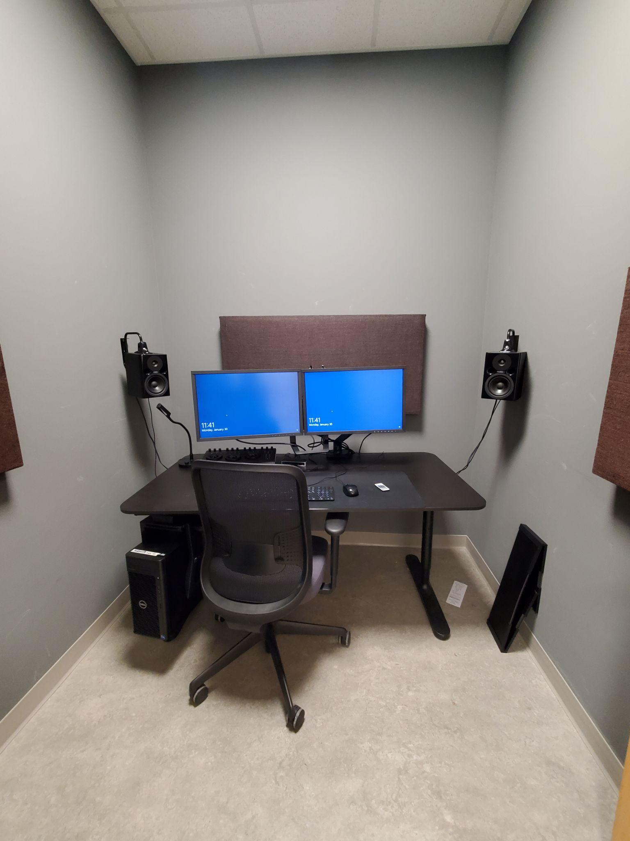
EACH EDIT SUITE CONTAINS:
Eizo CG2420 10-bit color corrected displays
Controlled lighting with grey & black surroundings.
6500K bias light / task light

Slide 4
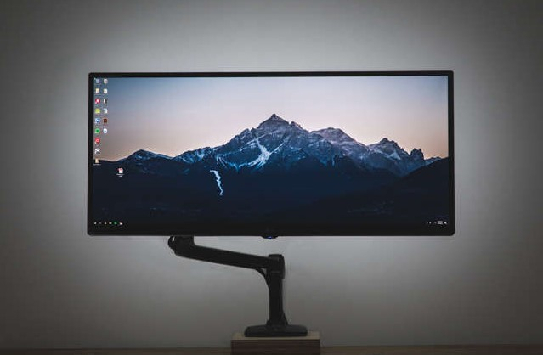
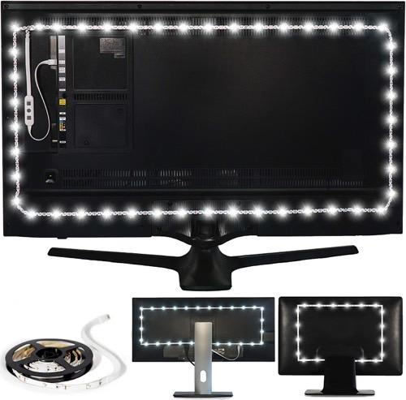
BIAS LIGHTING
LED lights fixed to the back of your monitor
Helps reduce eye strain
Improves perceived contrast–black seems darker and white seems brighter
White point of 6500K (approximate light “temperature” of daylight), the same as the colour calibrated monitor

Slide 5
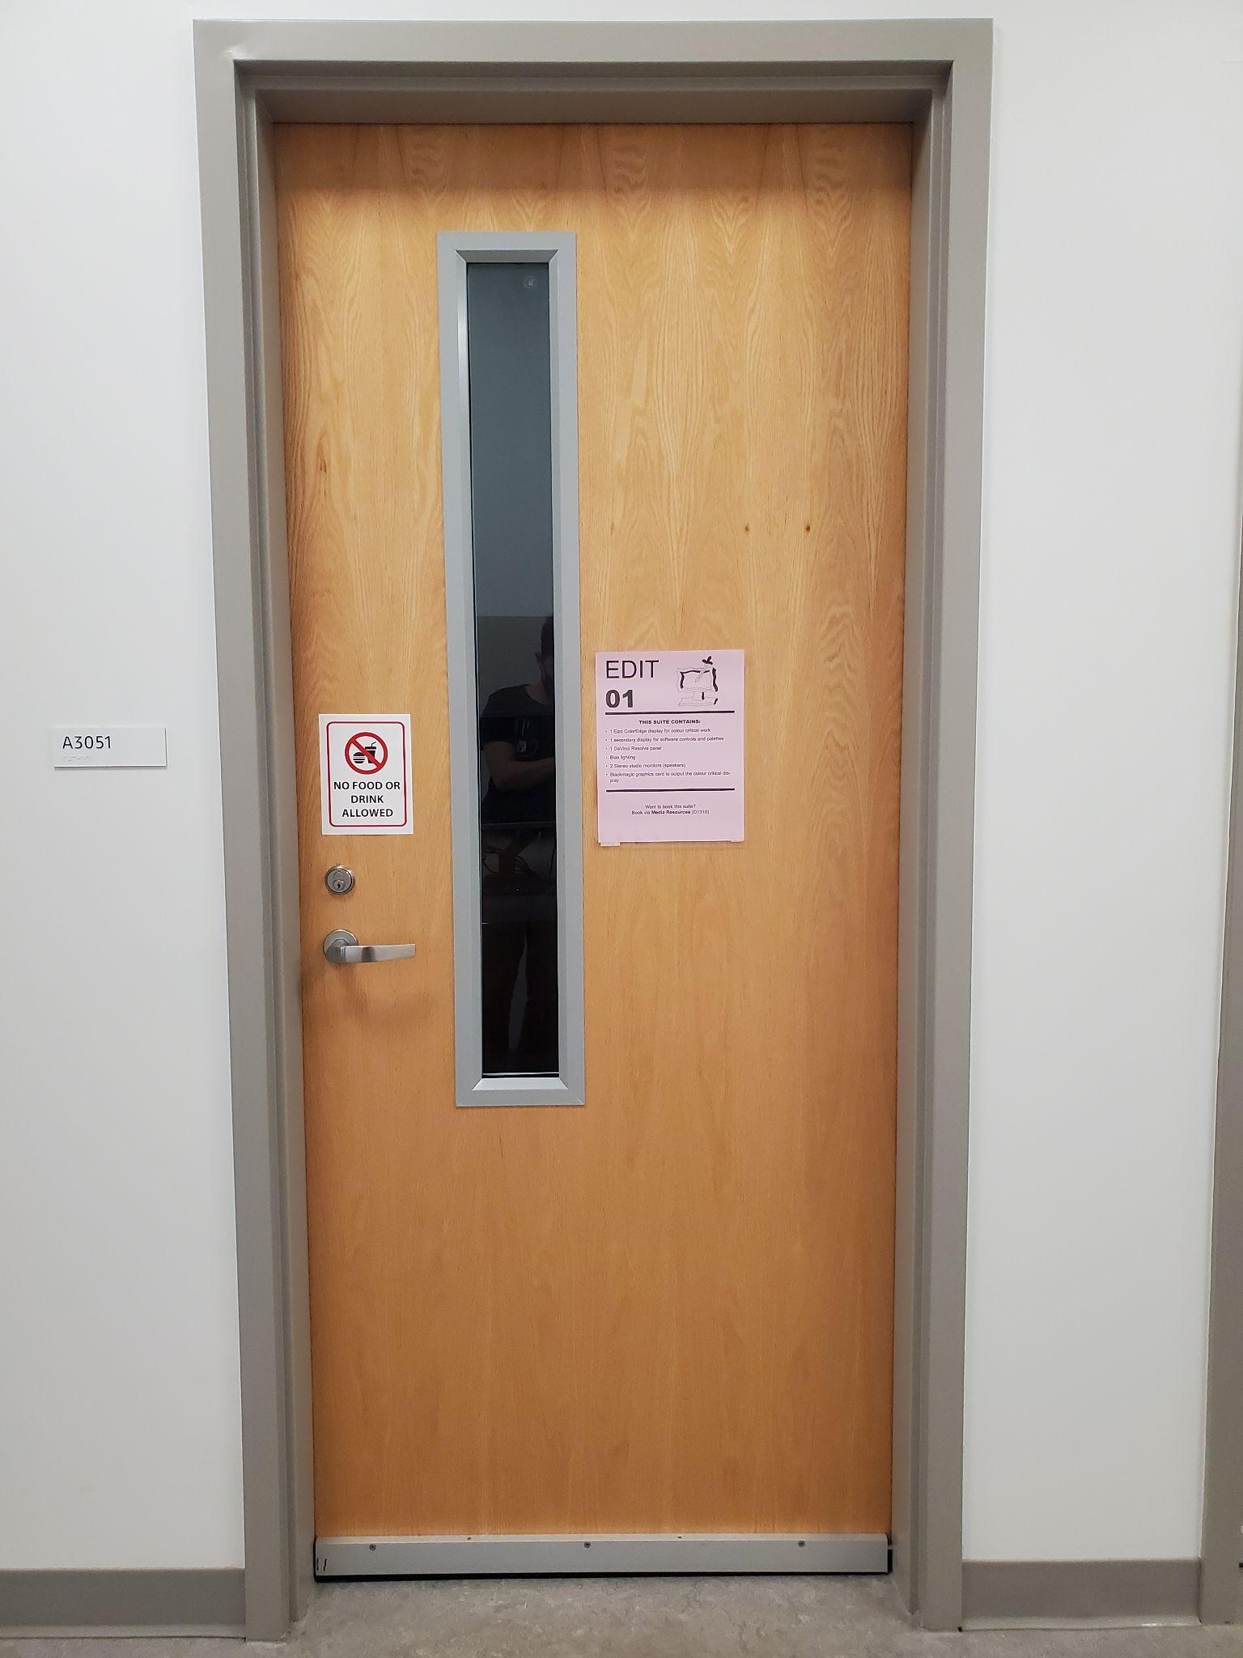
BOOKING PROCEDURE
Sign out physical key from Media Resources D1310 on the 1st floor
Ask for Animation Edit-01, Edit-02 or Edit-03
Rooms A3051, A3052 & A3053 on the 3rd floor

Slide 6
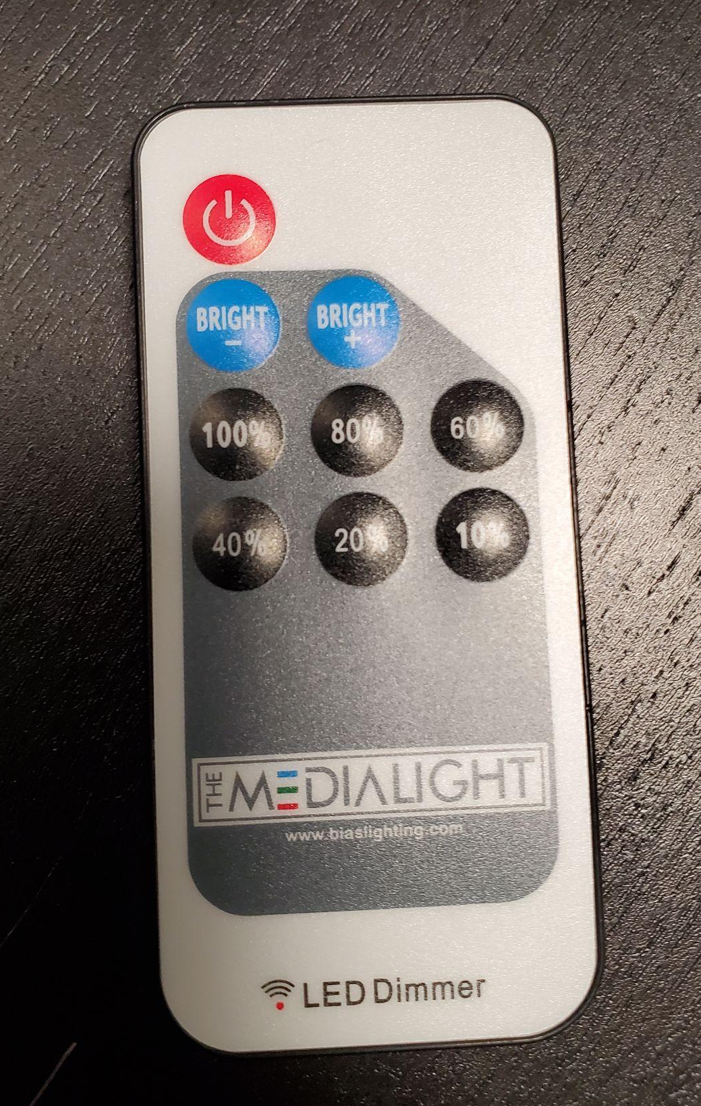
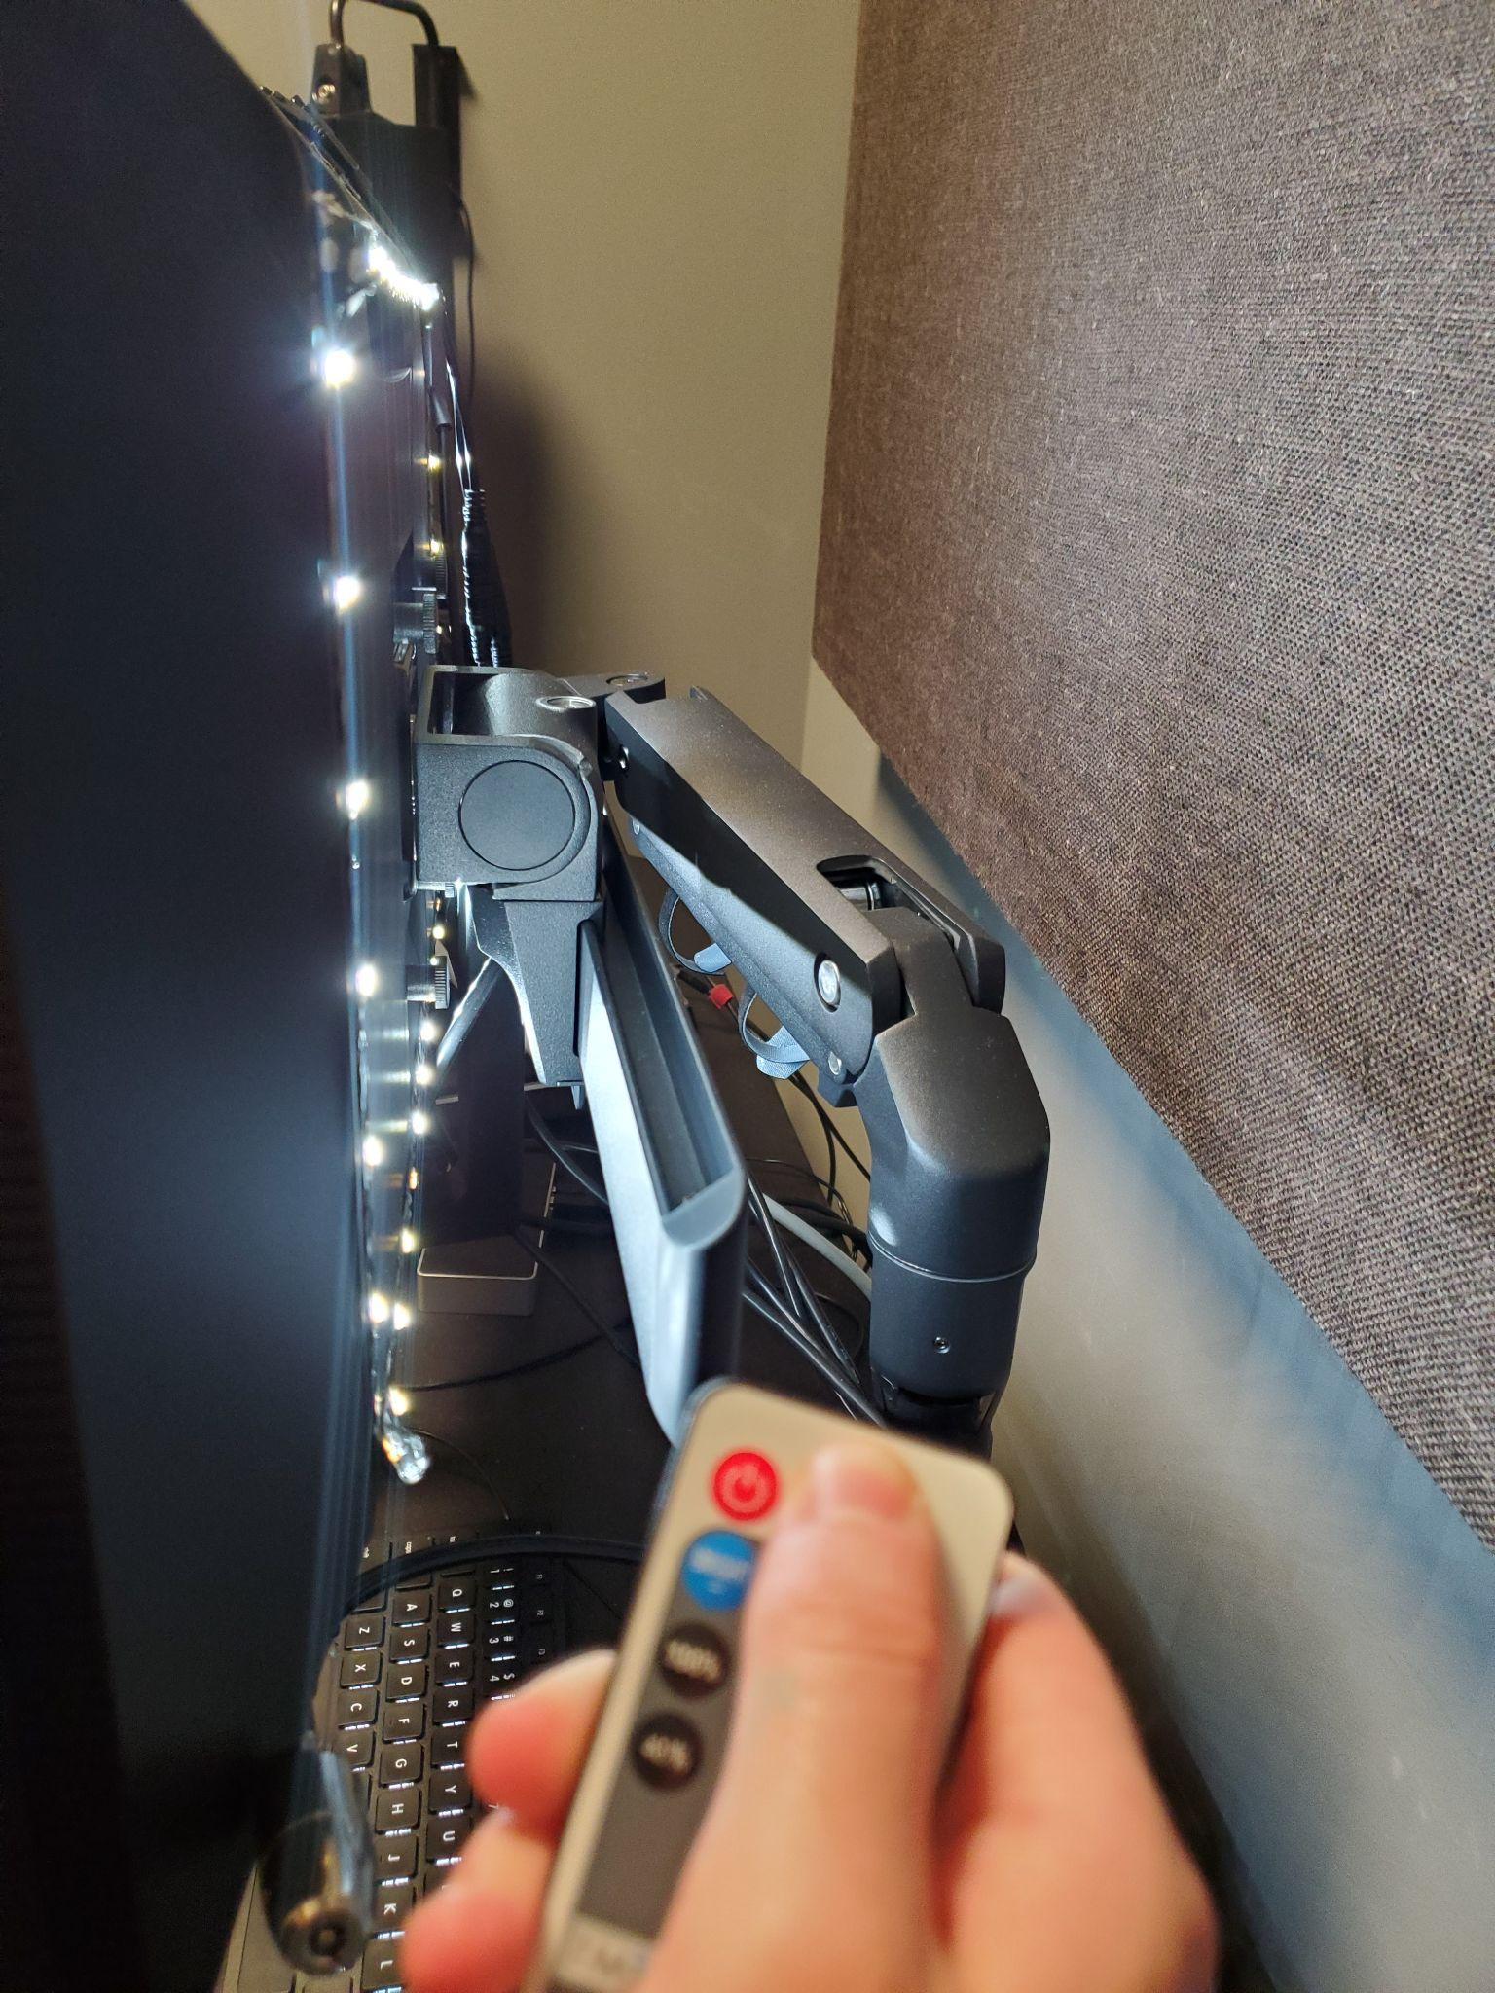
BEFORE YOU BEGIN COLOUR PICKING:
Turn off room lights.
Let display warm up 30 minutes.
Turn on bias lighting via pointing the remote at the back of the monitor and pressing the red power button on the top left (pictured on the left)
Ensure you’re viewing a lossless image file (no jpgs)
Use the indicated colour calibrated monitor. Both monitors are calibrated but the indicated reference one will be the most accurate
Open your colour managed software

Slide 7
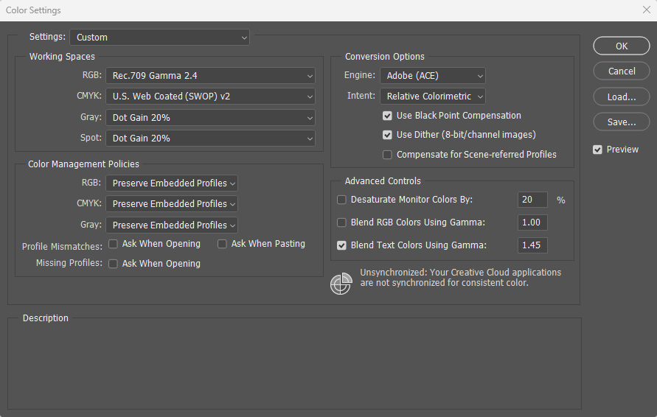
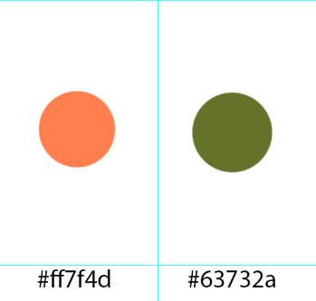
COLOUR PICKING IN PHOTOSHOP
Navigate to Edit > Colour Settings
Window pictured in this slide should pop up
Match settings to the ones indicated here
Start colour picking!
Good practice to also indicate the colour’s hex code to ensure you are using the exact colour if you are working with multiple softwares
Optional: Use this palette template

Slide 8
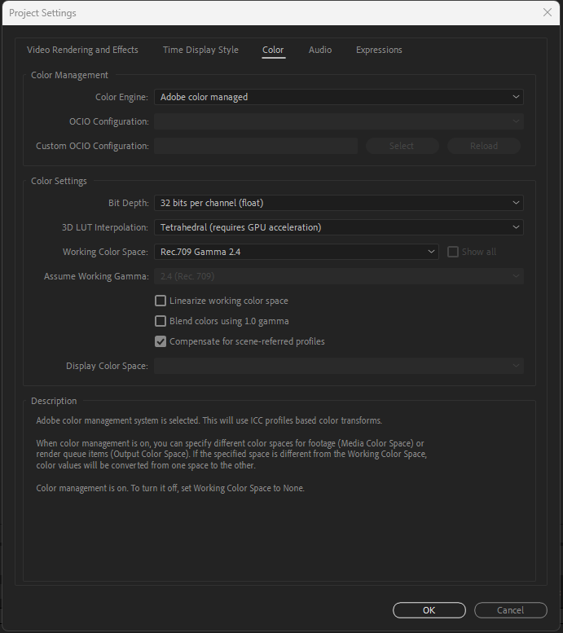
COLOUR PICKING IN AFTER EFFECTS
Navigate to File > Project Settings
Window pictured in this slide should pop up, navigate to “Color” tab
Match settings to the ones indicated here
Start colour picking!

